Slide 1
Oracle Database Performance Tuning
Presenter
Nitin Anjankar

Slide 2
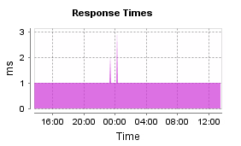
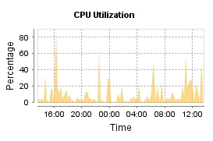
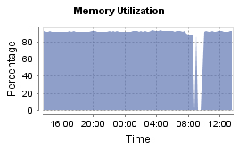
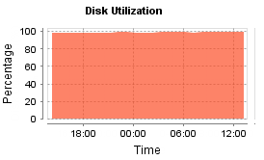
Oracle Databases Performance
(Oracle Performance Tuning Basics)
Notes:
In Slide Show mode, click the arrow to enter the PowerPoint Getting Started Center.

Slide 3
Agenda…
Finding the problem.
Approach towards resolution
Tool use for analysis

Slide 4
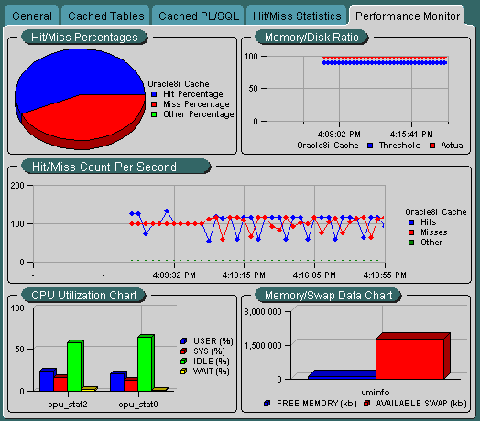
What Is Database Tuning?
The database tuning process consists of tasks such as:
Balancing the different types of competing resources in the database environment so that the most important applications have priority access to the resources they need to run.
Identifying and eliminating resource bottlenecks.
Optimizing the use of existing resources within the database environment.
Taking advantage of database features for the types of work performed on the database.

Slide 5
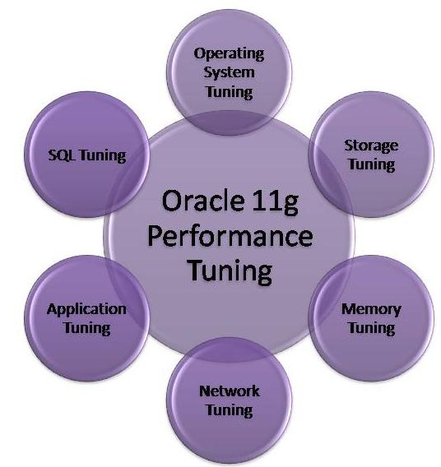
What Are the Types of Performance Tuning?
Tuning an Oracle database can involve tuning the application, the instance, and the space usage in a database.
Application/SQL Tuning –SQL Reuse Opportunities, Optimal Data Access.
Instance/Memory Tuning –Instance Parameter Optimizations.
Space/Storage Management –Appropriate Space Management.
OS Tuning –Tuning OS parameter like SWAP, Memory.
Network Tuning –Network latency & loads.

Slide 6
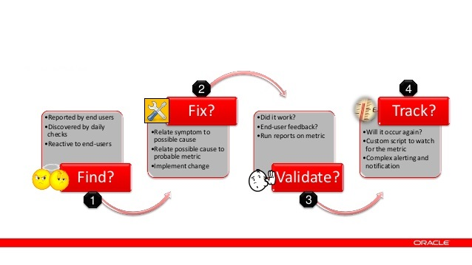
Database Performance Analysis..

Slide 7
What data needs to be collect
Since when you are facing this slowness issue ?
Is the slowness persistent or does it varies based on the time of the day?
Is it happening with any specific user/s or across the globe ?
Is the complete application slow or issue with any specific module/operation/job ?
If it is with any specific module/operation/job then what queries are associated with this ? What actually it does ?
if its query specific, do we have the explain plan when it was working fine?
Is it newly added or old module/operation/job ?
What is its previous completion/response time ?
What is the current completion/response time ?
Is there any changes happened at application/database/server level in recent past? If yes what kind of changes done ?
Is only one job/query slow or the entire database slow:
List of all tables used in your job:
Good Time (1 hour duration when the job was running fine):
Bad time (1 hour duration when the job was running the slowest):
After when has the issue started occurring, any particular date or database change or event ?
Will you be able to replicate the issue on the database at our will ?
Any select queries you can provide which are running slow ?
Have you connected with any other team. If yes, any findings from their side ?

Slide 8
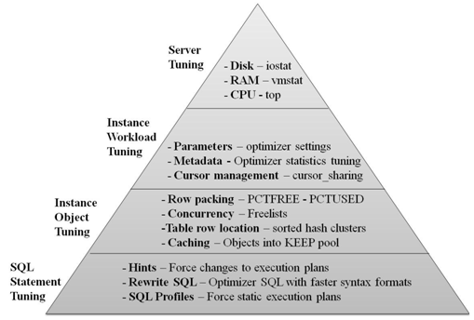
Decentralize the issue..
Component | Commands
Memory | free, vmstat, mpstat, iostat, sar
CPU | vmstat, mpstat, iostat, sar
I/O | vmstat, mpstat, iostat, sar
Processes | ipcs, ipcrm
Network | netstat

Slide 9
Query Processing..
Oracle 10g+ uses something called the CBO (Cost-Based Optimizer) which determines the most efficient way to execute a SQL statement after considering many factors related to the objects referenced and the conditions specified in the query. This determination is an important step in the processing of any SQL statement and can greatly affect execution time.
A SQL statement can be executed in many different ways, including the following:
Full table scans
Index scans
Nested loops
Hash joins
The output from the optimizer is a plan that describes an optimum method of execution. The CBO formulates this plan based on statistics. A combination of correct index-usage and decent statistics is key for well-performing queries. Sometimes the CBO can make decisions that seem incorrect — this may be as a result of stale or inaccurate statistics.

Slide 10
Locating Slow Queries
Finding the guilty SQL is the first step in solving the issue. There are many approaches to this. Chances are if you have a performance problem you already know the offending SQL.
The following are some simple ways of finding resource-intensive SQL.
Obtaining the Execution Plan
Enterprise Manager
AWR Views
ASH Reports
Real Time SQL Monitoring(SQL Trace)

Slide 11
Xplan for SQL
Plan hash value: 454993881
--------------------------------------------------------------------------------------------
| Id | Operation | Name | Rows | Bytes | Cost (%CPU)| Time |
--------------------------------------------------------------------------------------------
| 0 | SELECT STATEMENT | | 2 | 176 | 13 (16)| 00:00:01 |
| 1 | NESTED LOOPS | | 2 | 176 | 13 (16)| 00:00:01 |
|* 2 | HASH JOIN | | 1 | 65 | 11 (19)| 00:00:01 |
|* 3 | TABLE ACCESS FULL | PS_DEPT_TBL | 330 | 14850 | 6 (0)| 00:00:01 |
| 4 | VIEW | VW_SQ_1 | 660 | 13200 | 4 (25)| 00:00:01 |
| 5 | HASH GROUP BY | | 660 | 13860 | 4 (25)| 00:00:01 |
|* 6 | INDEX FAST FULL SCAN | PS1DEPT_TBL | 660 | 13860 | 3 (0)| 00:00:01 |
| 7 | TABLE ACCESS BY INDEX ROWID| PS_NAMES | 2 | 46 | 2 (0)| 00:00:01 |
|* 8 | INDEX RANGE SCAN | PS_NAMES | 2 | | 1 (0)| 00:00:01 |
--------------------------------------------------------------------------------------------
Predicate Information (identified by operation id):
---------------------------------------------------
2 - access("D"."EFFDT"="VW_COL_1" AND SYS_OP_DESCEND("D"."EFFDT")=SYS_OP_DESCEND(
"VW_COL_1") AND "SETID"="D"."SETID" AND "DEPTID"="D"."DEPTID")
3 - filter("D"."EFF_STATUS"='A')
6 - filter(SYS_OP_UNDESCEND(SYS_OP_DESCEND("EFFDT"))<=SYSDATE@! AND
SYS_OP_DESCEND("EFFDT")>=SYS_OP_DESCEND(SYSDATE@!))
8 - access("N"."EMPLID"="D"."MANAGER_ID")

Slide 12
Xplan comparision

Slide 13
Optimizing the Optimiser
Optimizer inputs
Table and index
Structure
Cardinality
Estimates
Object Statistics
DB parameters
And config
IO and CPU
Estimates
System Statistics
Cost estimate

Slide 14
Most possible/common causes..
There are many approaches to this finding issue and its possible solutions.
The following are some simple ways of possible causes.
Wait Events / Resource contention (Views: V$SESSION, V$LOCK, V$SQLTEXT, V$ACTIVE_SESSION_HISTORY, V$SESSION_WAIT_HISTORY, GV$SESSION_WAIT)
Large number of long running scripts other than problematic one ( Views : V$SESSION, V$PROCESS)
Multiple Active & Inactive sessions counts. (Views : V$SESSION)
Old object(table/index/sys) statistics (Views : DBA_TAB_STATISTICS, DBA_IND_STATISTICS)
Incorrect optimization/execution plan(utility : dbms_xplan)
Fragmentation (Views : V$DBA_SEGMENTS, V$DBA_TABLES)
Getting database I/O wrong (V$SQLAREA, V$SYSSTAT, PROCESS ,V$SESSION ,V$SESSTAT ,V$SESS_IO ,V$BGPROCESS)
Bad use of cursors and the shared pool (Parameter : CUSRSOR_SHARING , SGA, PGA)
High Amount of Recursive (SYS) SQL. (View : V$SYS_TIME_MODEL, V$SESS_TIME_MODEL)
Duplicate indexing / Full table scan (Views : V$OBJECT_USAGE, V$OBJECT_VIEW)
Explain PLAN changes (Views : V$DBA_HIST_SQL_PLAN)

Slide 15
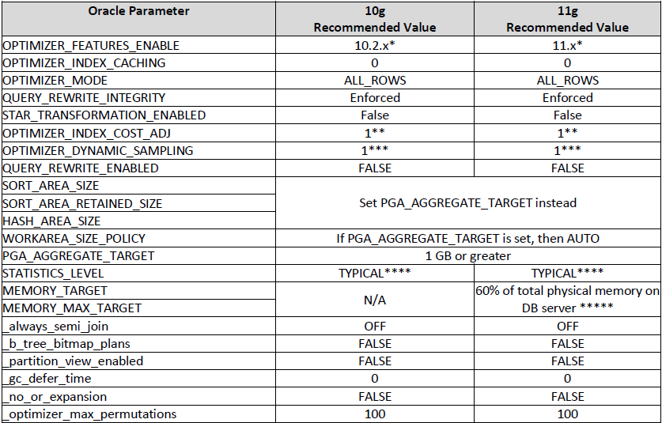
Recommended Database Parameters for Oracle 10g and 11g

Slide 16
Some useful scripts..
Here are the links for all scripts mentioned in this document:
Blocking/Waiting Sessions
Detect long running scripts
Index Usage
Locks and inactive sessions
Hit ratio and CPU usage
Tablespace utilization
Disk I/O
CPU usage
Fragmentation

Slide 17
References
http://www.oracle.com/technetwork/articles/schumacher-analysis-099313.html
http://vsbabu.org/oracle/sect05.html
http://www.dba-oracle.com/t_statistics_level_parameter.htm
http://www.myoracletips.in/2013/02/what-is-pctfree-and-pctused-in-oracle.html
http://rwijk.blogspot.com/2008/03/dbmsxplandisplaycursor.html

Slide 18
More References..
SQL Tuning
Trace files
SQLT output (MOS Doc: 215187.1)
Trace Analyzer (MOS Doc : 224270.1)
AWR Report (MOS Doc : 748642.1)
AWR SQL Report (awrsqrpt.sql)
11g Real-Time SQL Monitoring
SQL Tuning Advisor
PL/SQL Tuning
Product logs
PL/SQL Profiler (MOS Doc : 808005.1)
Forms Tuning
Forms Tracing (MOS Doc : 373548.1)
Generic MOS Doc : 438652.1
Reports Tracing
MOS Doc: 111311.1
Database Tuning
AWR Report (MOS Doc : 748642.1)
ADDM report (MOS Doc : 250655.1)
Active Session History (ASH) Report
LTOM output (MOS Doc : 352363.1)
Middletier Tuning
JVM Logs
Third Party Tools
OS
OSWatcher (MOS Doc : 301137.1)

